Slide 1
Xamera (Pre-Beta) Image Processing Instructions
By Deniz K. Acikbas

Slide 2
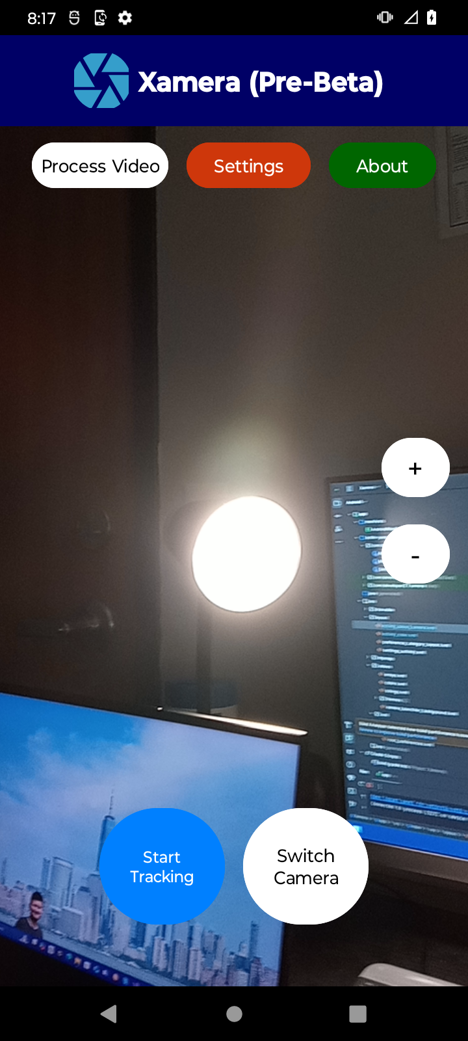
1- Start tracking the object

Slide 3
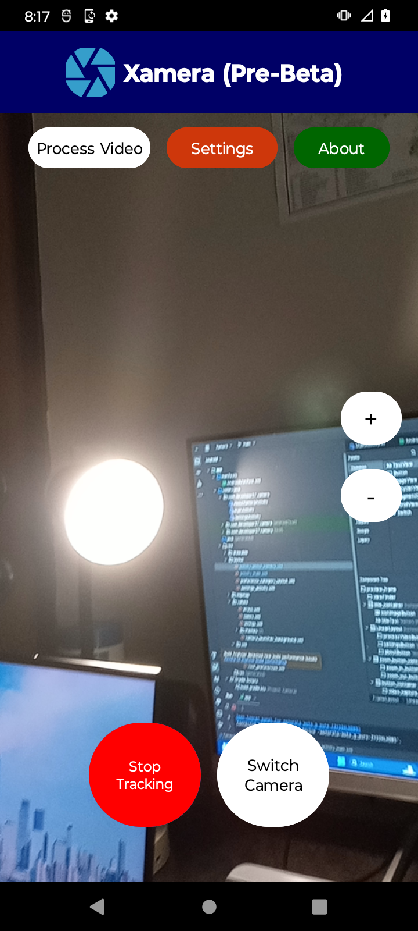
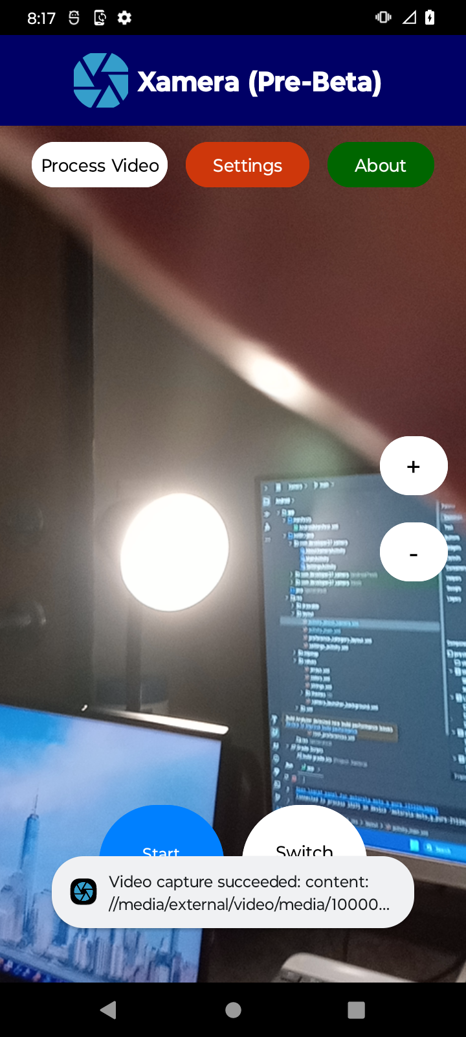
2- Stop and save tracking video

Slide 4
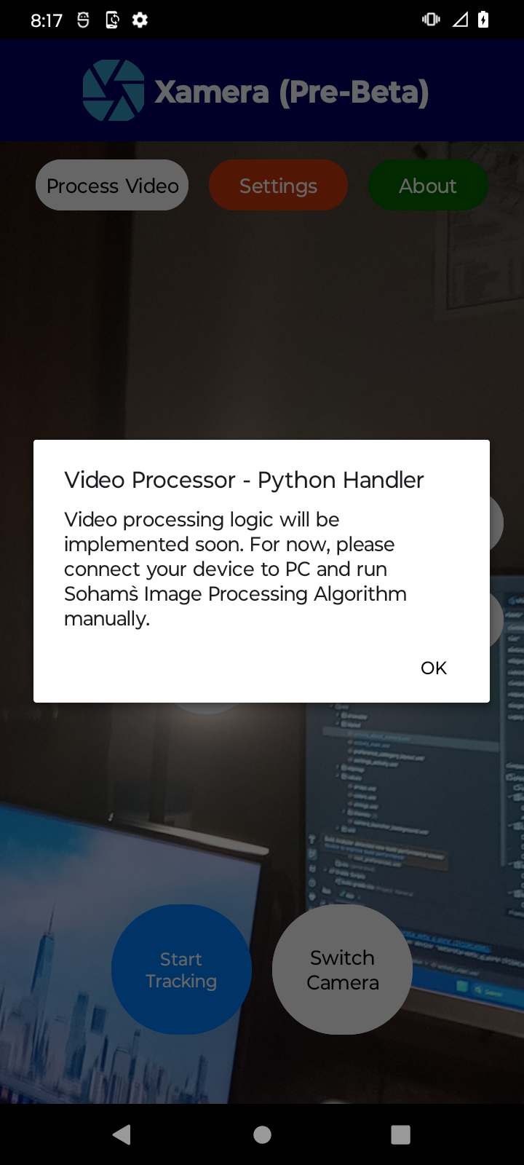
3- Follow the instructions

Slide 5
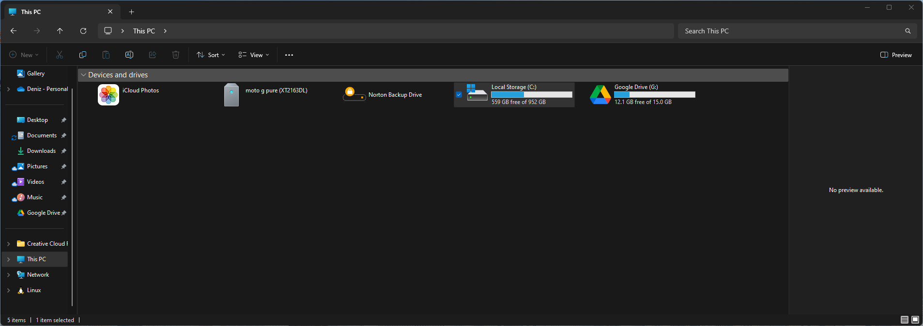
4- Connect your device to PC

Slide 6
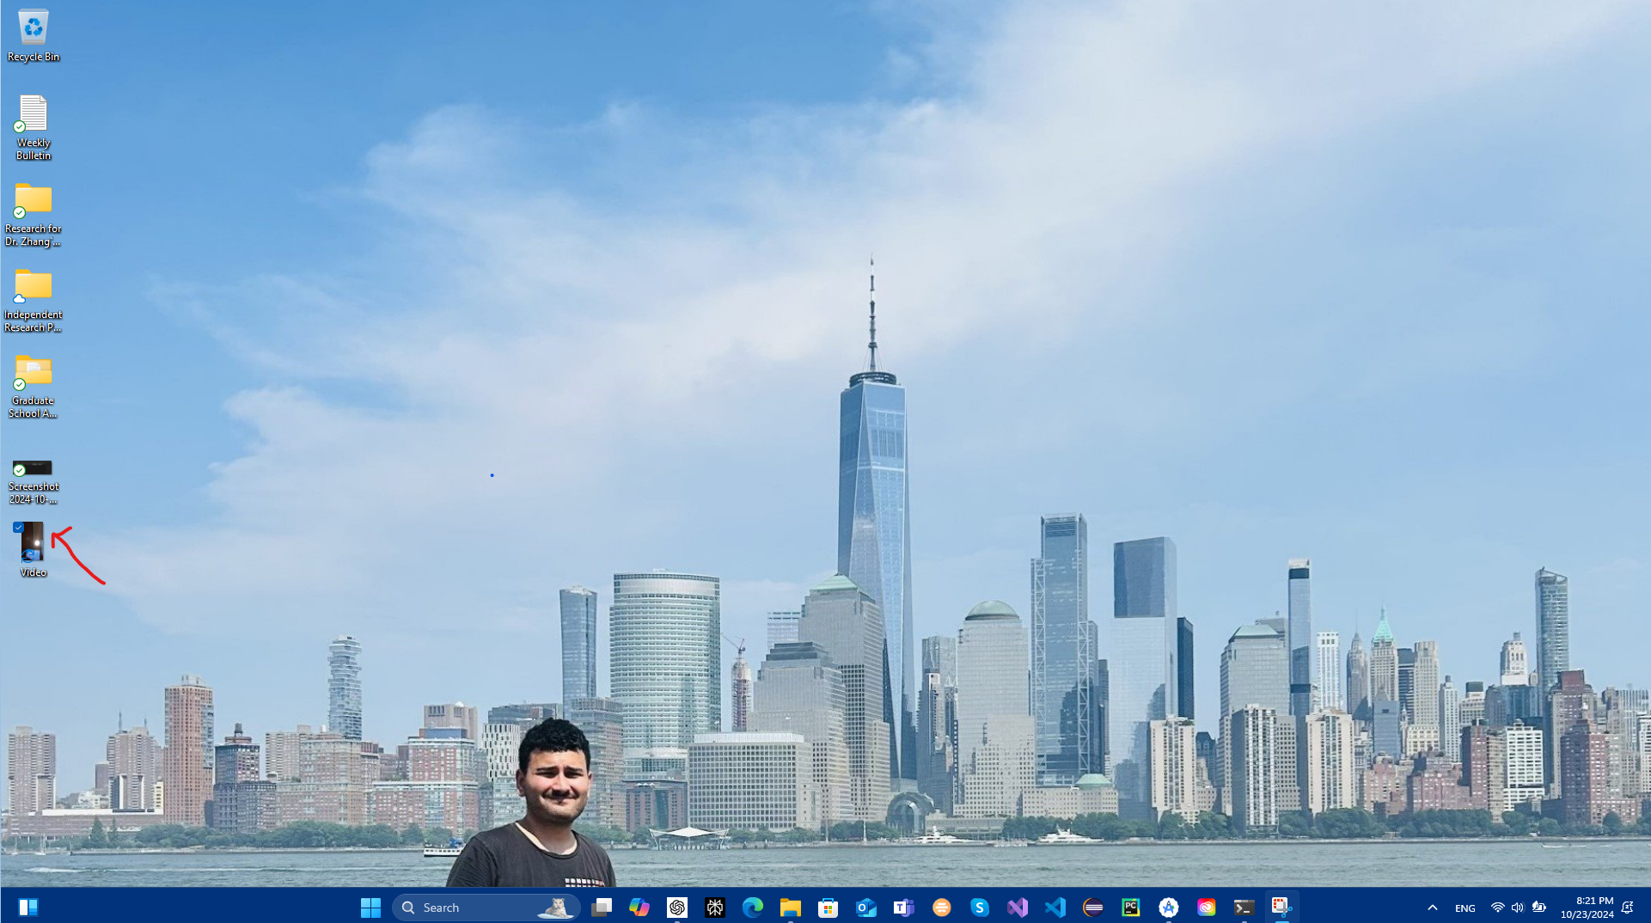
5- Save file to a relevant location

Slide 7
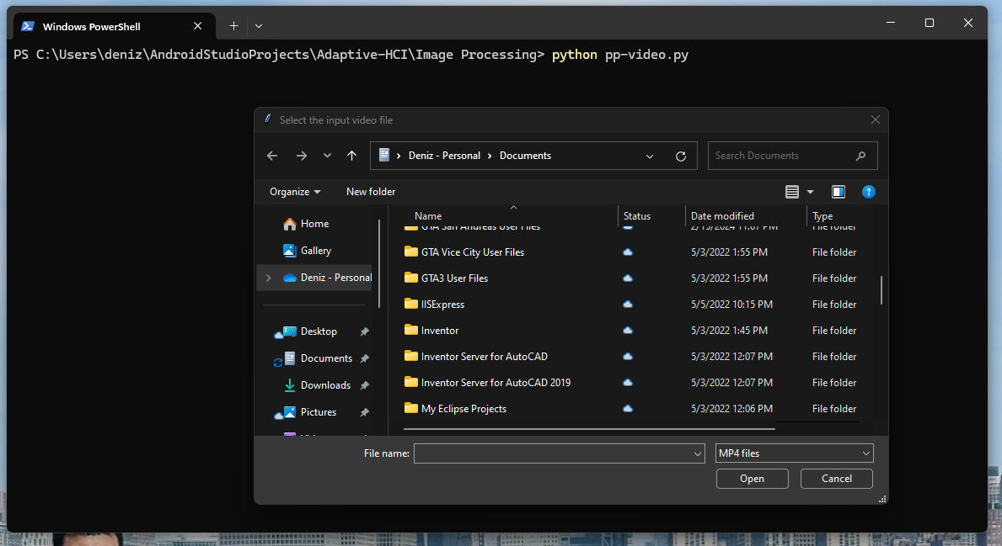
6- Trigger Soham`s Algorithm

Slide 8
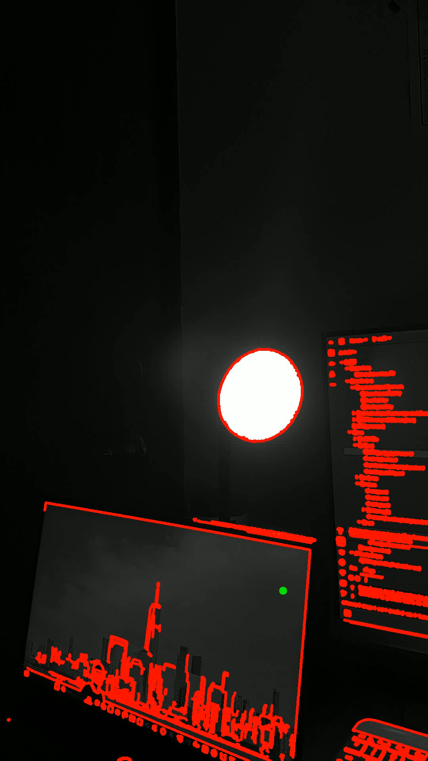
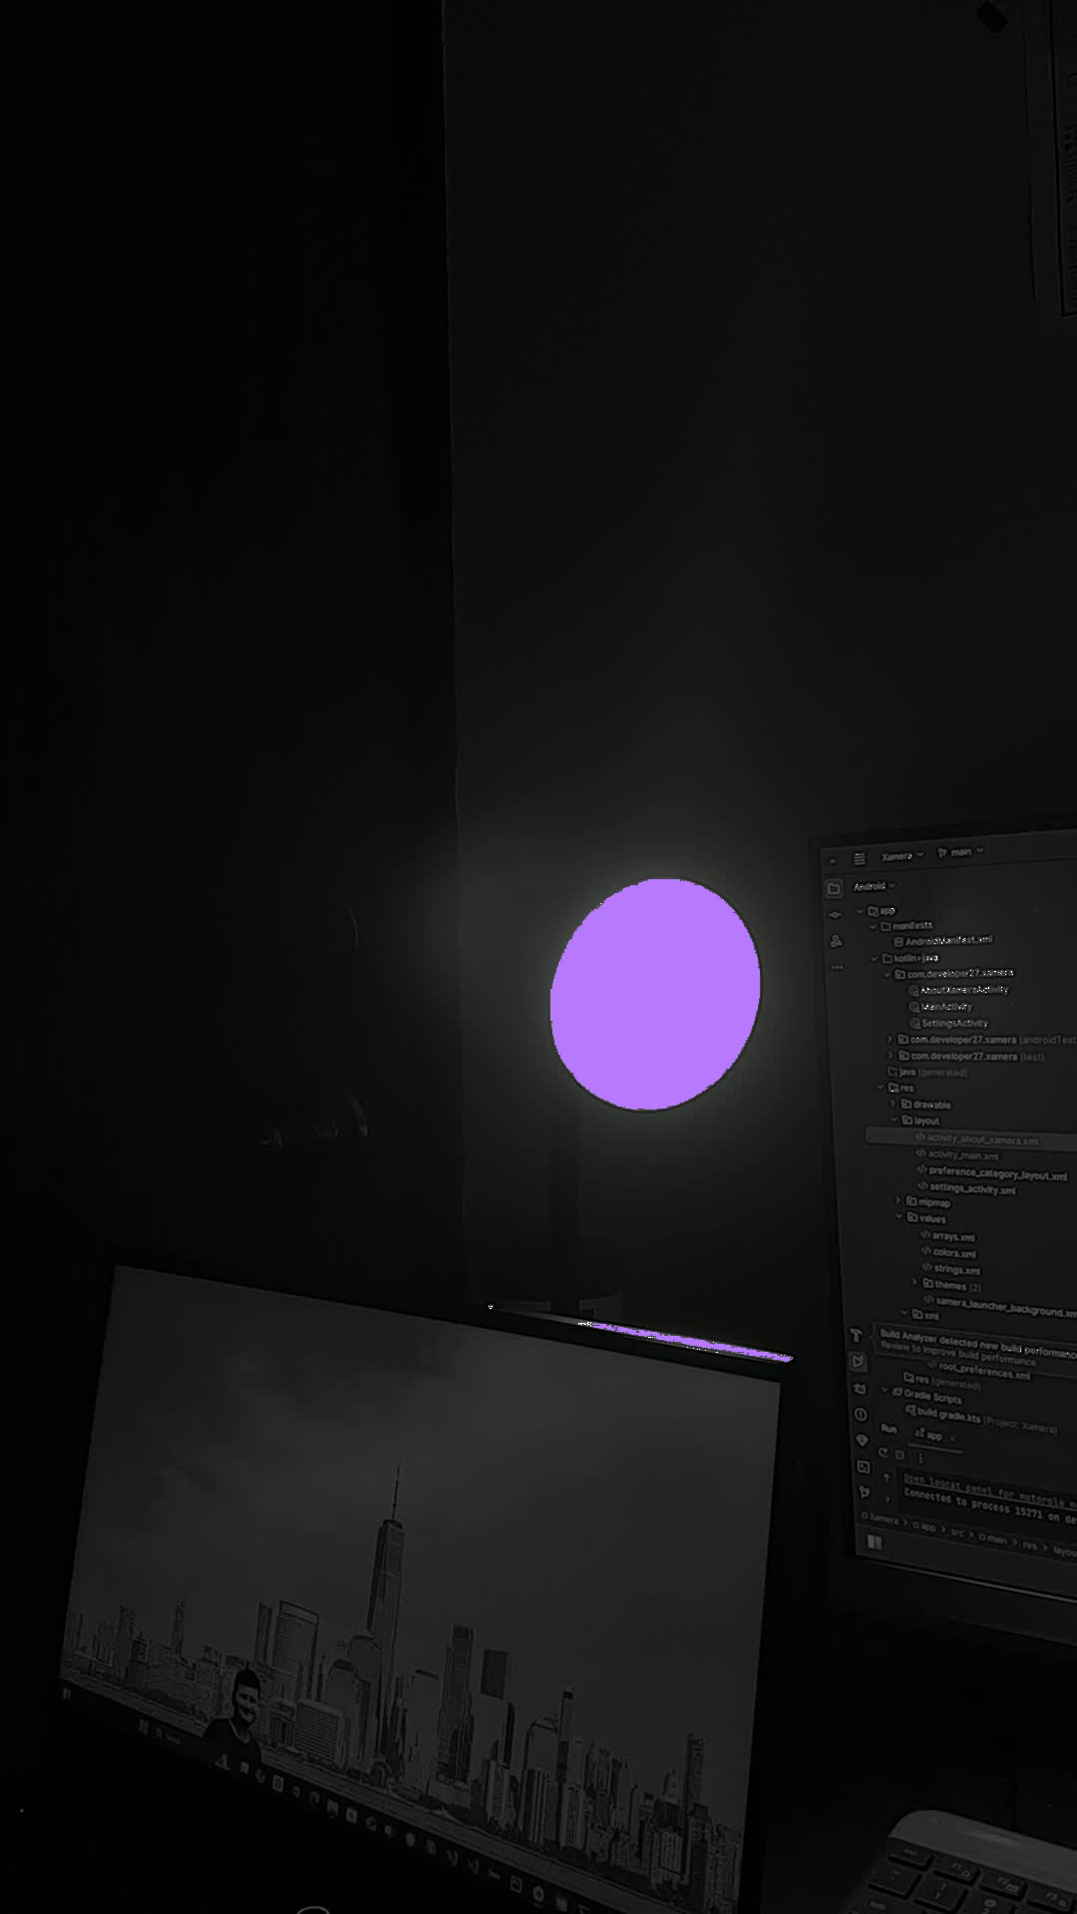
7- Here is the end product

Slide 9
Any questions about this use case?

